Slide 1
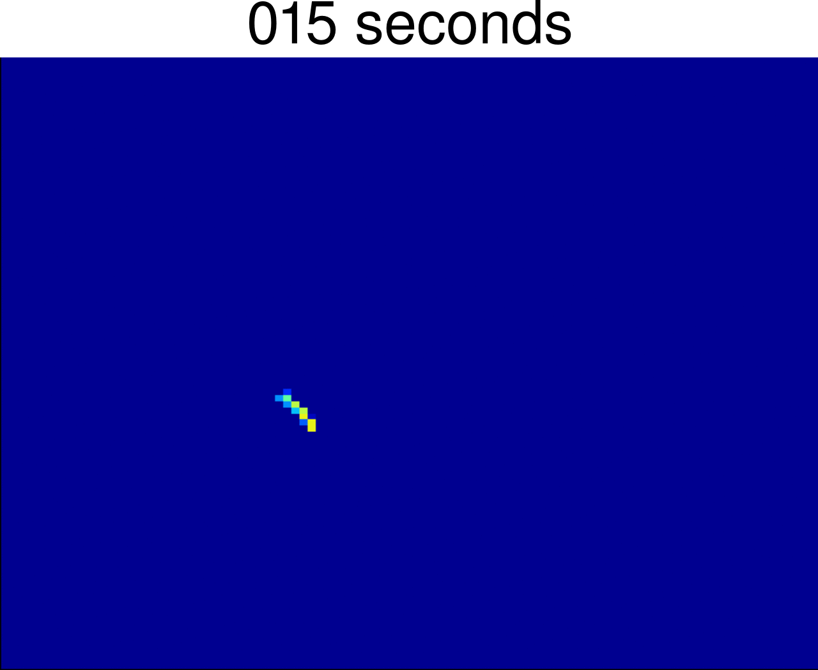
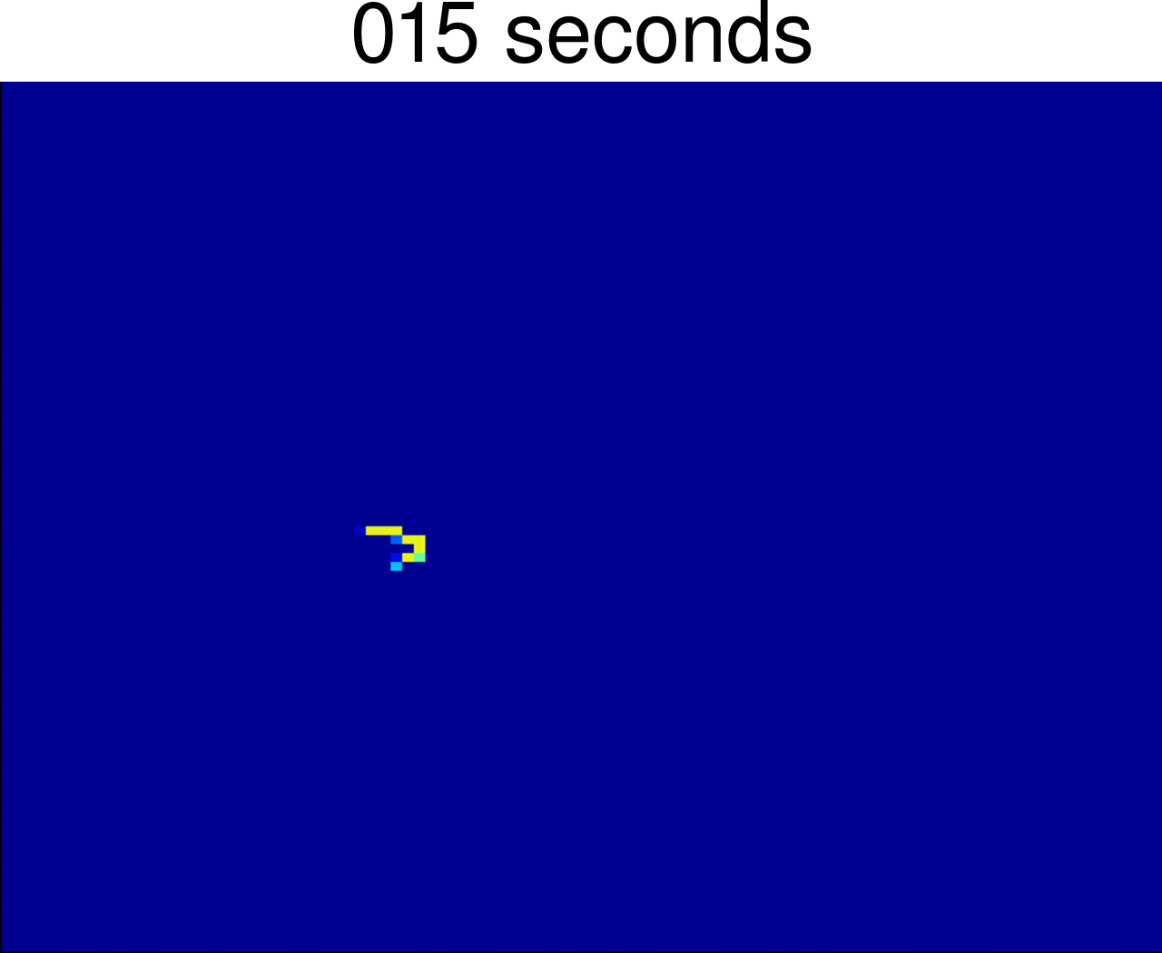
ASSIGNMENT 1
COMPETITION RESULTS
150120029
150110132
http://web.itu.edu.tr/kocca/BLG456E/Homework1/

